Slide 1
Project 1001 Iranian churn -by alan jiji varghese

Slide 2
Project description
This dataset is randomly collected from an Iranian telecom company's database over a period of 12 months.
We have to train a ML model on the given dataset to correctly predict the target column which is Churn or Not Churn.

Slide 3
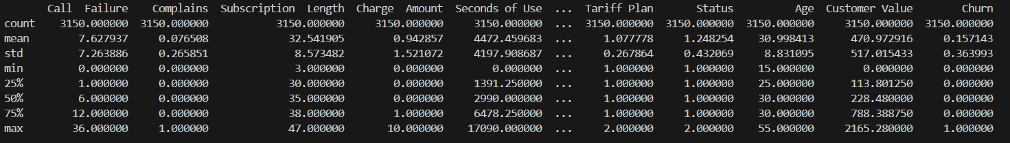
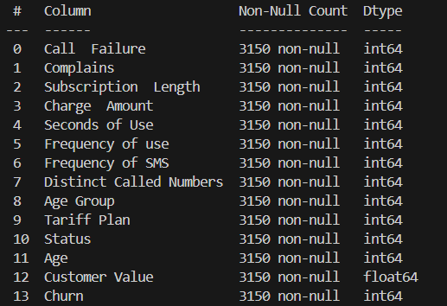
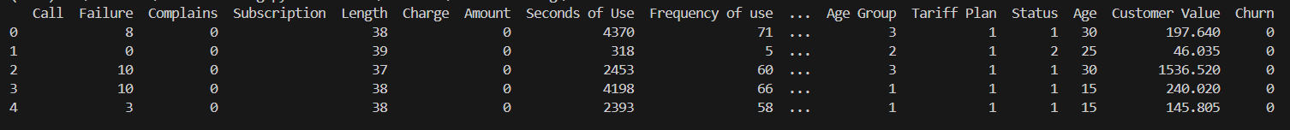
EDA
Data.describe()
Data.info()
Data.head()

Slide 4
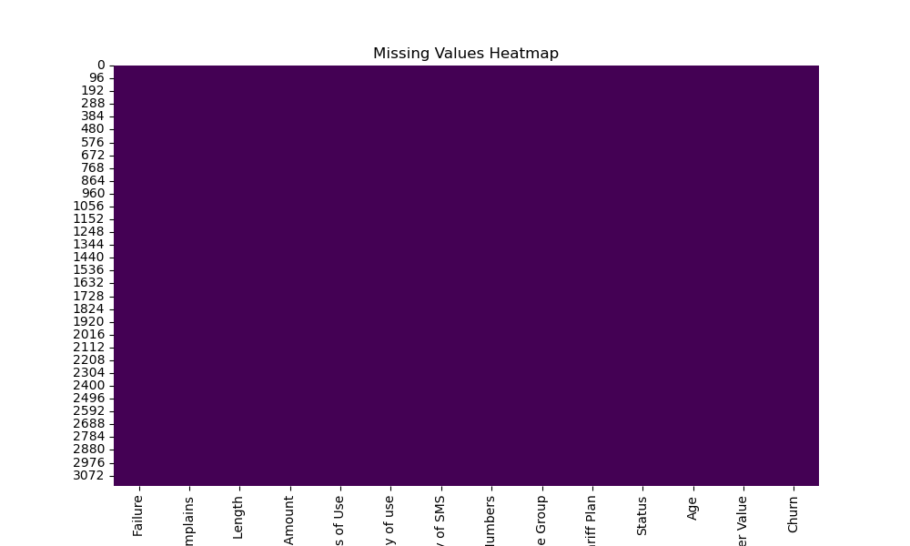
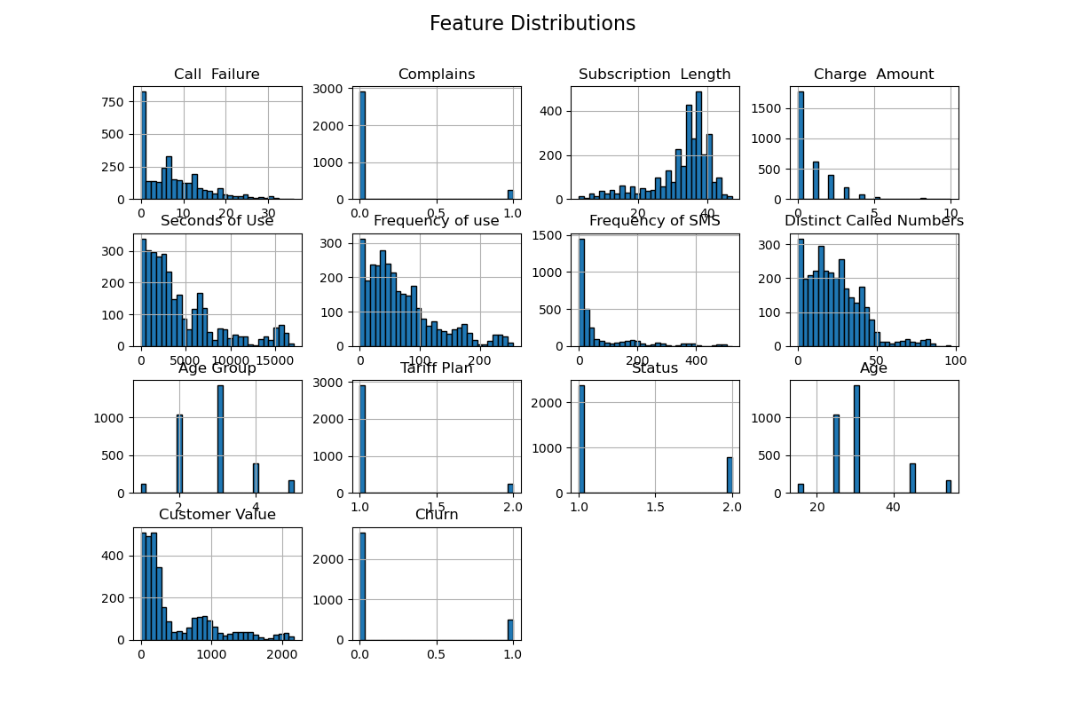
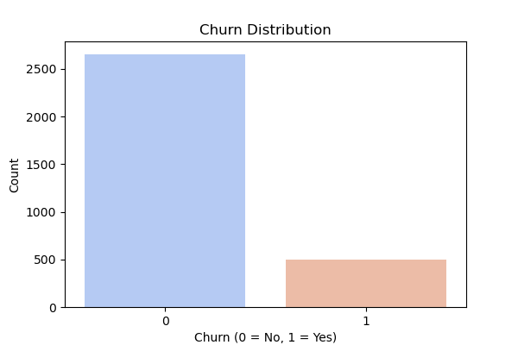
Graphs plotted during eda + preprocessing
Heatmap for missing values
Distribution of various features via Histogram
Distribution of target value via Bar Graph
This barplot shows us that how many people are present in each target class i.e ‘churn’ and ‘not churn’. As we can see there is a majority of people who are in the ‘not churn’ class
Since the heatmap returns a monochromatic screen we can conclude that there are zero null values in the given dataset
This graph shows us the distribution of every feature over the entire data

Slide 5
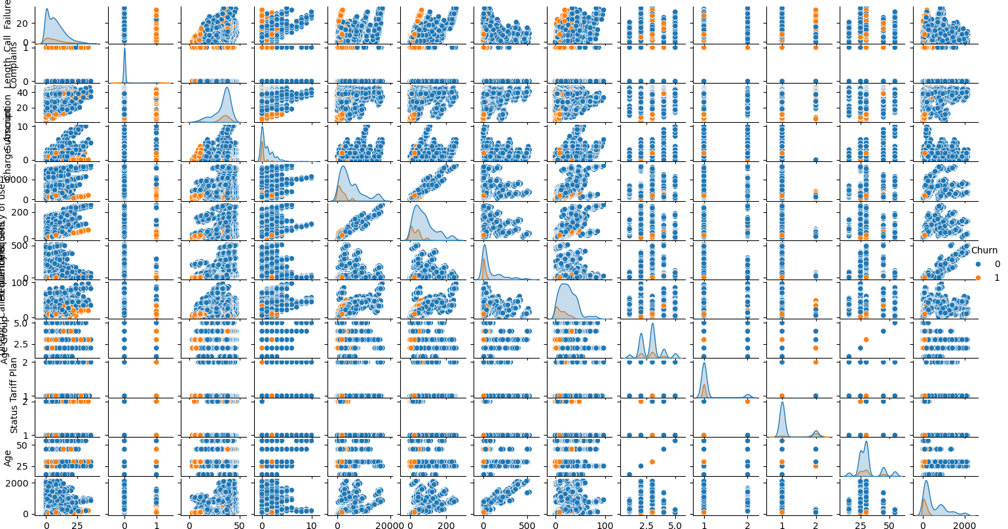
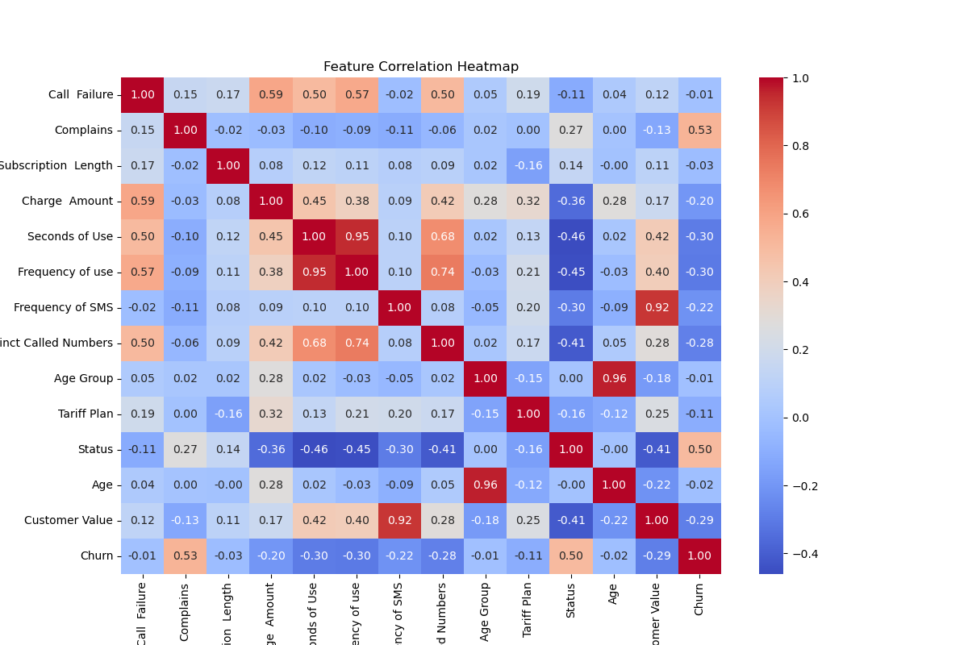
Graphs plotted during eda + preprocessing
Here we have the pairplot and heatmap of the given data.
The pairplot gives us the scatterplot of all the various features and how they are distinguishable from each other. It is useful for exploring relationships between multiple numerical variables in a dataset.
The heatmap gives us the level of correlativity between every feature, by analysing the heatmap we can decide on which feature to remove due to similarity with other and we usually include feature with higher correlativity to the target column (positive and negative both). From these graphs we can conclude that we should most definitely include complains, status, seconds of use and frequency of use as they have comparatively higher correlativity with the target column.

Slide 6
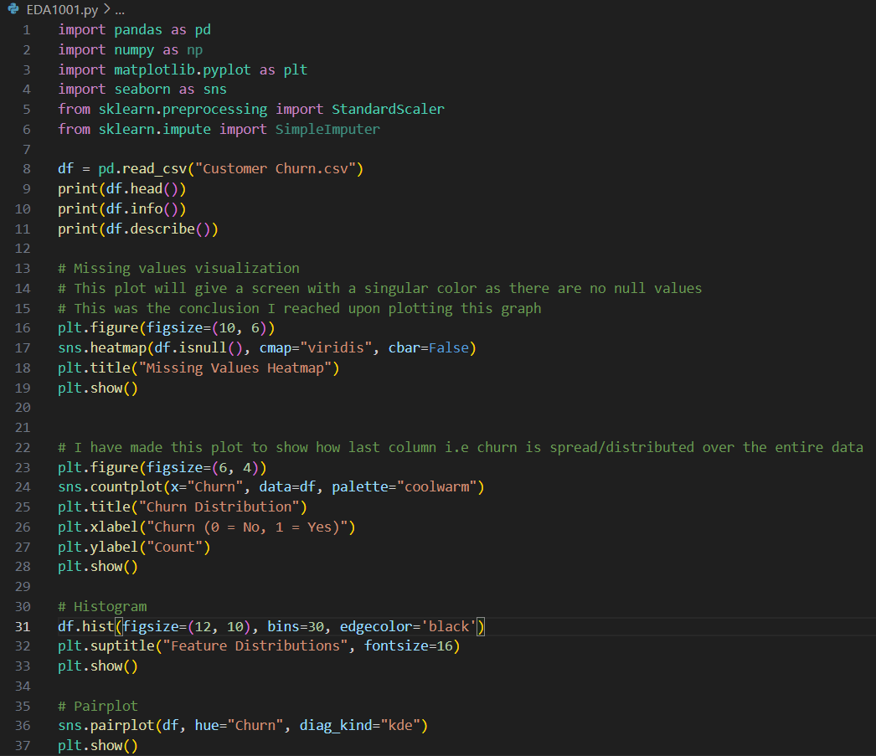
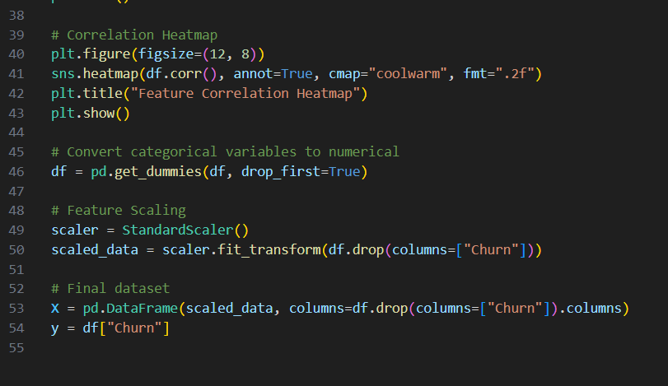
EDA + PREPROCESSING CODE
The explanation of the code is written as comments in the .py file and you can also see them in the screenshot of the code
Various steps and methods used:
Handling of missing values
One-hot encoding
Feature scaling
Correlation heatmap (Feature Selection)
Pair plots
Bar graphs
Histogram

Slide 7
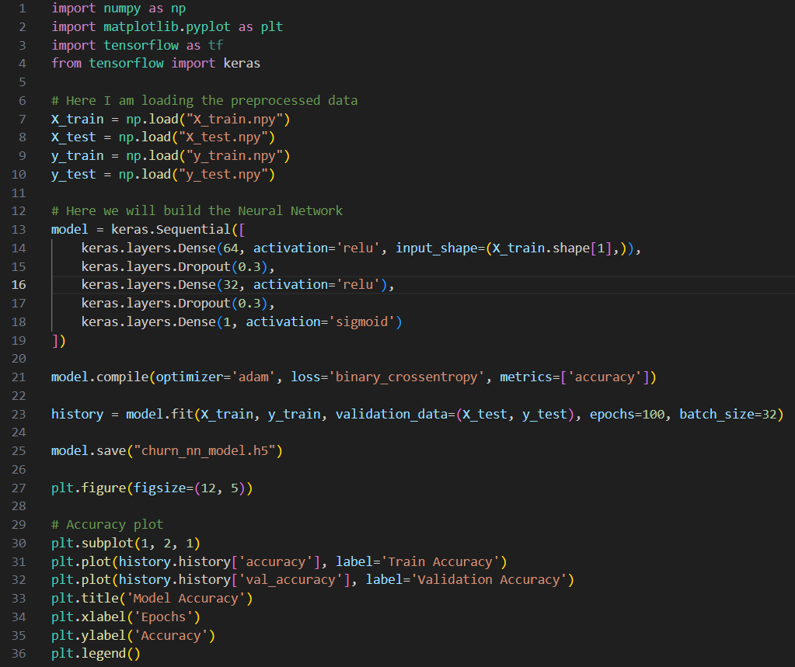
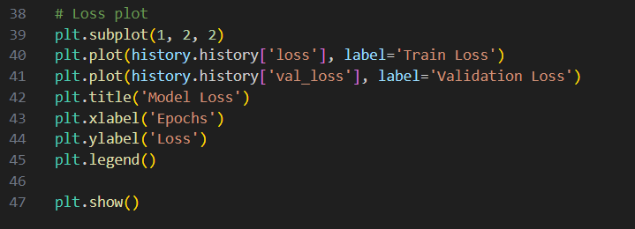
Model training code
Key steps of Model Training:
Loading the preprocessed data created during EDA and preprocessing
Building a NN using ReLu activation
Compiling the model with Adam optimizer and accuracy as metrics
Training the model on 100 epochs (1-2% higher than 50 epochs)
Saving the model
Analysing the performance of the model by plotting its accuracy plot and loss plot (included in the next slide)

Slide 8
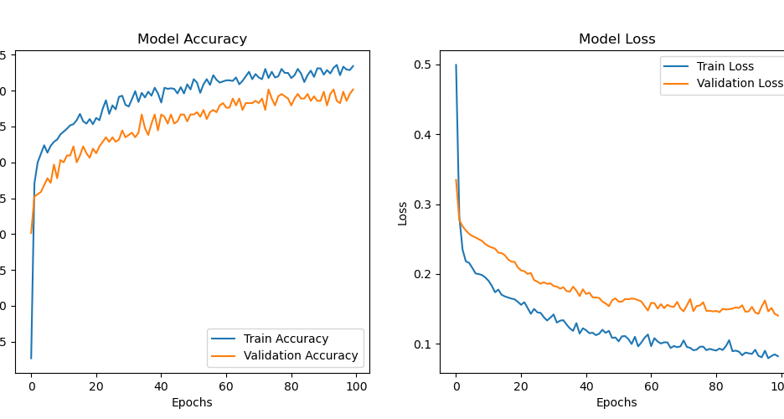
Model training results
Following are the observed results from model training:
Training accuracy – 97.00%
Training loss – 0.0786
Validation accuracy – 95.08%
Validation loss – 0.1406

Slide 9
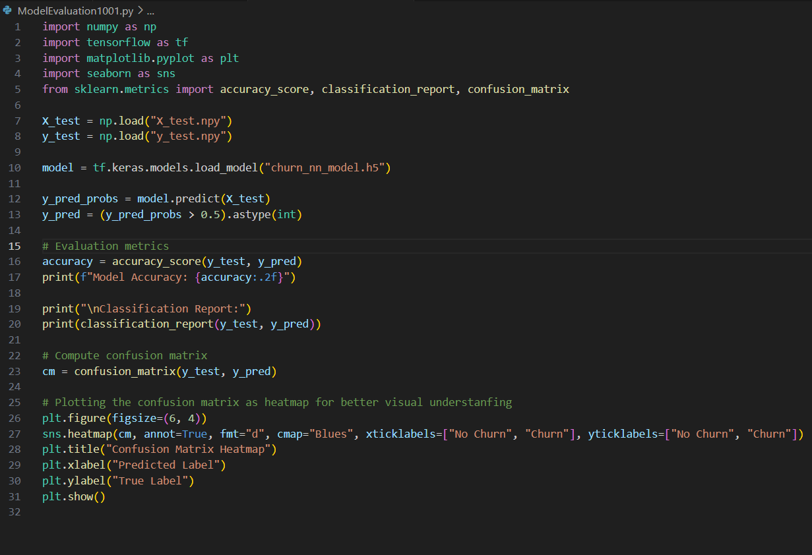
Model evaluation code
Key steps of Model Evaluation:
Loading the test data
Loading the trained model
Making predictions on the test data
Calculating accuracy
Printing the classification report
Computing the confusion matrix
Presenting the confusion matrix as a heatmap

Slide 10
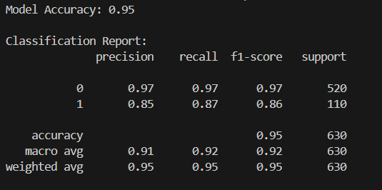
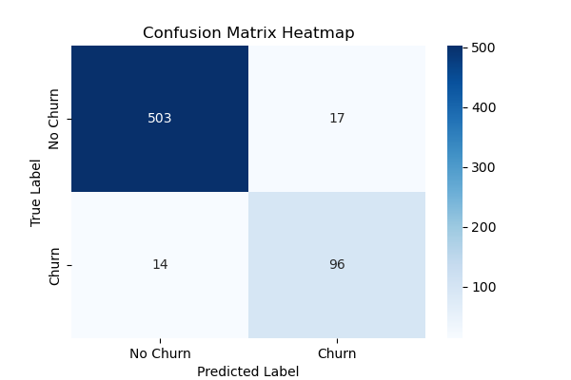
Model evaluation results
Evaluation Metrics used :
Accuracy
Final model evaluation accuracy :
95%

Slide 11
thankyou

